Slide 1


Discounting and Fisheries Sustainability
Rashid Sumaila
Fisheries Economics Research Unit
Fisheries Centre, University of British Columbia
r.sumaila@fisheries.ubc.ca
BIRS Workshop, Banff, May 10, 2007

Slide 2
Fish for today; fish for tomorrow
Should this be a goal for humanity?
Is it an achievable goal?
  Observations from the field.
Is economics helping?
  Reasons for observations.
Can economics help?
  Suggestions for tackling the problem;
  Intergenerational discounting.
Way forward.

Slide 3
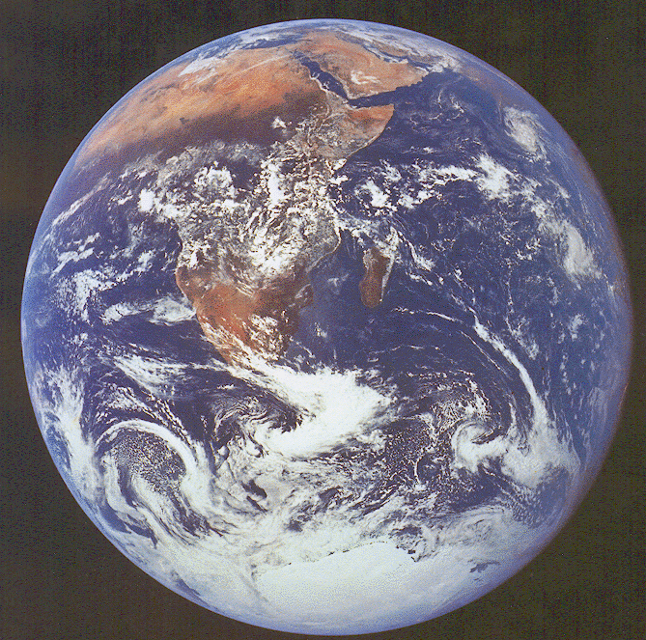
Should this be a goal for humanity?
“The Earth and the fullness of it belongs to every
generation, and the preceding one can have no right to
blind it up from posterity”
(Adam Smith, 1766 Lecture on Jurisprudence).
Photo: NASA

Slide 4
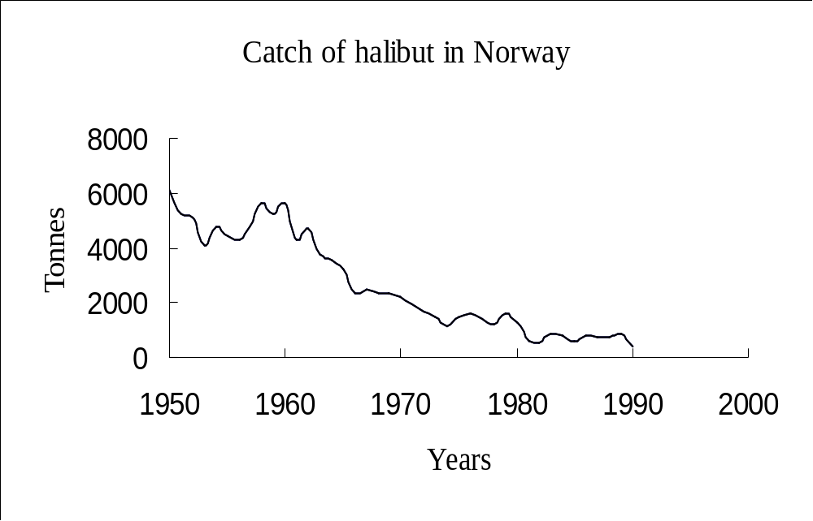
Is this an achievable goal?

Slide 5
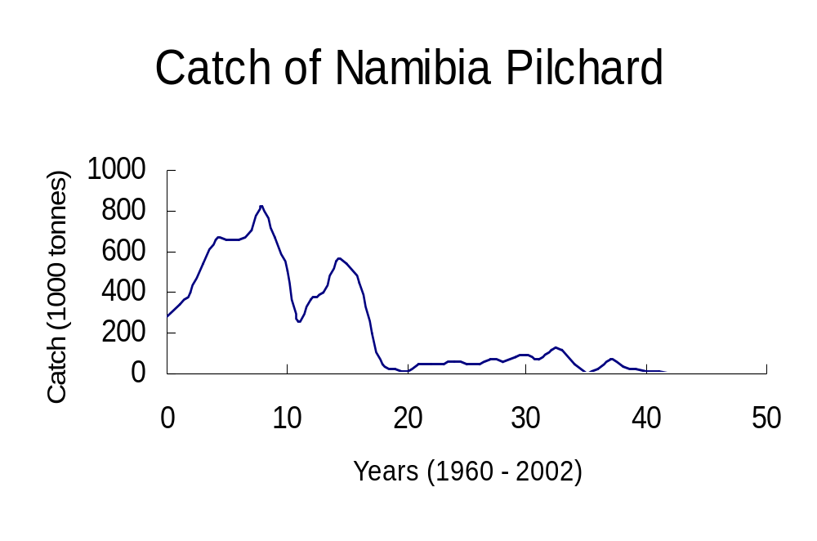

Slide 6
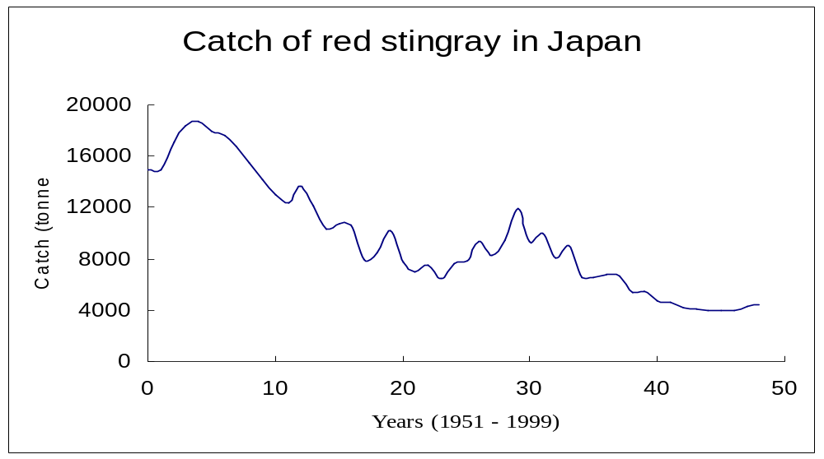

Slide 7
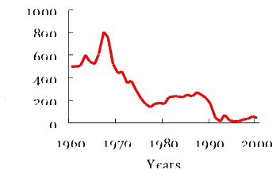
Catch profile of Newfoundland cod

Slide 8
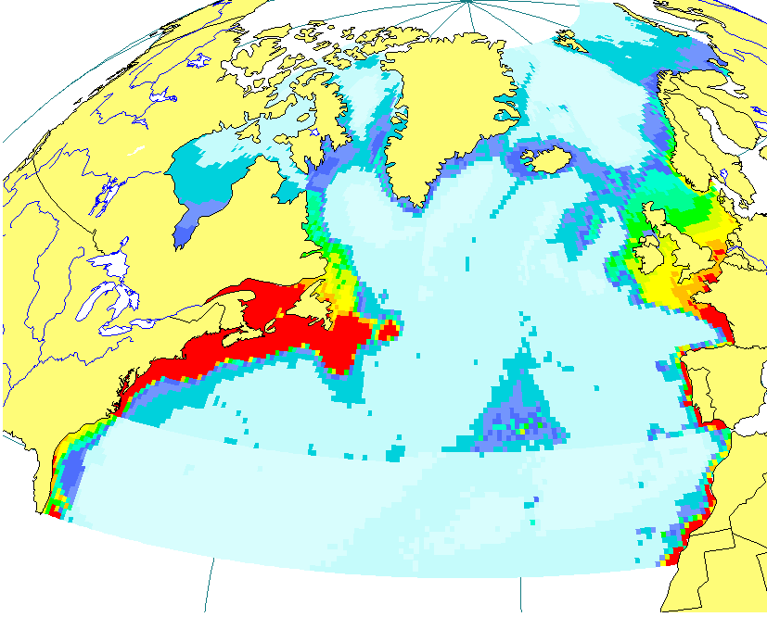
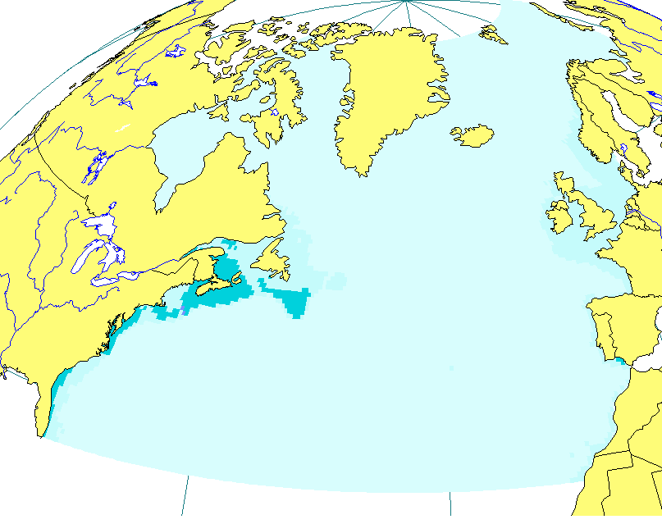

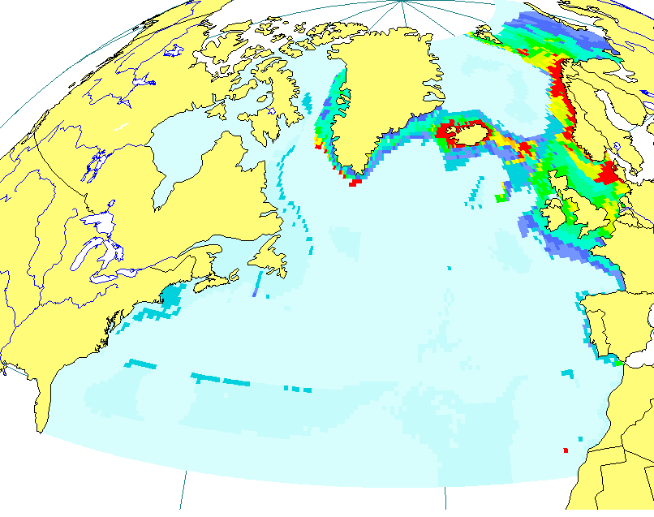

Fish biomass and fishing intensity
Biomass;
Fishing intensity.
Biomass
Fishing Intensity
Biomass t·km⁻²
1.8-2.5
1.5-1.8
1.2-1.5
0.9-1.2
0.7-0.9
0.6-0.7
0.4-0.6
0.3-0.4
0.2-0.3
0.1-0.2
0-0.1
0-0
1900
1999
Courtesy V. Christensen

Slide 9
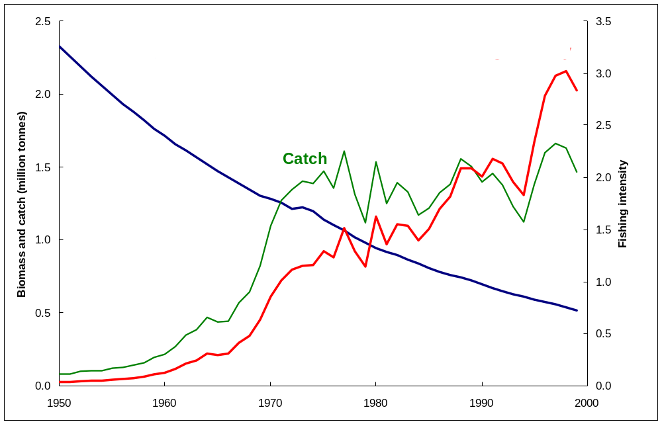
North West Africa: Changes in key fisheries variables

Slide 10
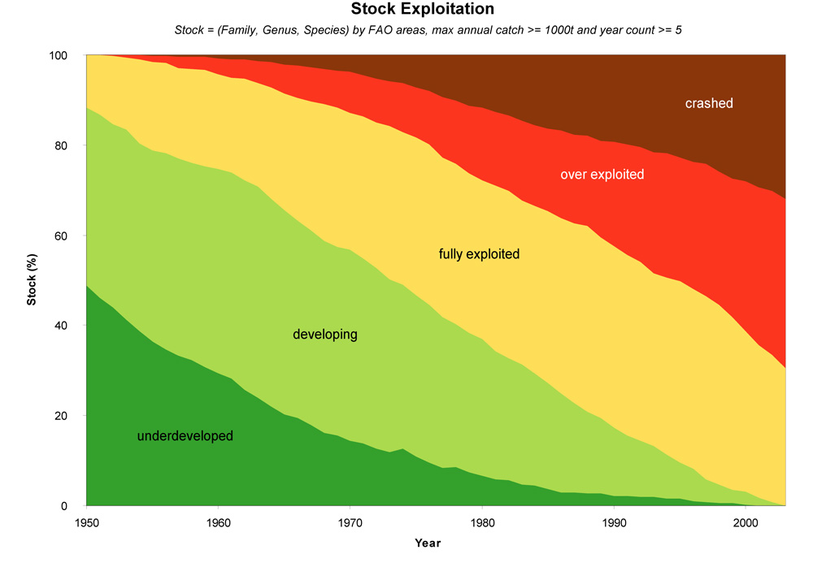
State of fish stocks over time
Source: Froese and Pauly (2004).

Slide 11
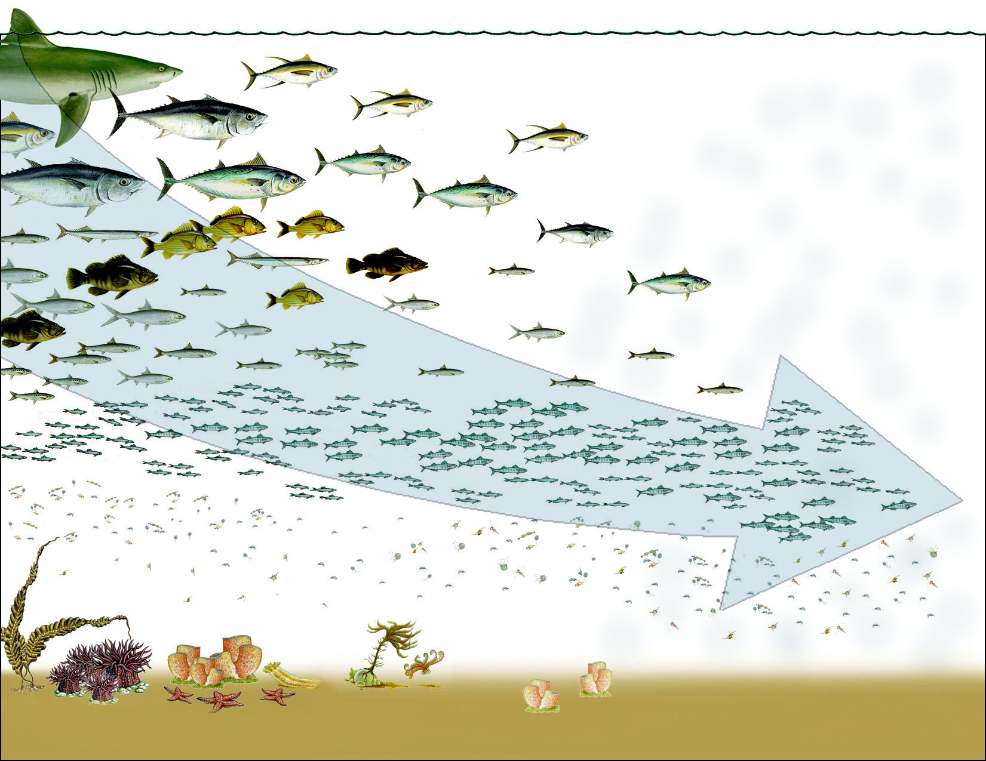
The flow of marine ecosystem services through time
Source: Pauly & MacLean (2003).

Slide 12
Is economics helping?
Why these pictures?
1st order problem:
  Open access/common property.
2nd order problem:
  Sole ownership not sufficient: Why?

Slide 13
2nd order problem: Sole ownership …
Will not necessarily capture all fish values (or total economic value; TEV);
May suffer what I term the ‘frontloading’ problem.

Slide 14
The valuation problem
The economic theory of valuation calls for the computation of TEVs made up of both use & non-use (market & non-market) values from fish.

Slide 15
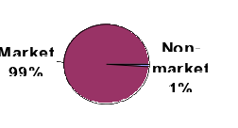
The practice of valuation
Survey of 9 leading environmental & resource economics journals (1994-2003):
  # of articles published: 4705;
  # articles containing the words ‘non market’ or ‘existence value’ or ‘bequest value’: 43.
Sumaila (in press)

Slide 16
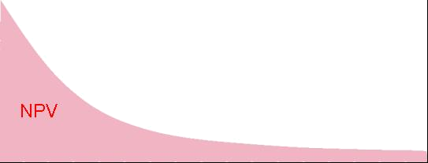
The ‘frontloading’ problem
“Egoism is the law of perspectives as it applies to feelings
according to which what is closest to us appears to be large and
weighty, while size and weight decrease with our distance
from things” (attributed to Nietzche, 1844-1900).
Future benefits from today’s perspective
Value
Present
Future
Discounting in economics

Slide 17
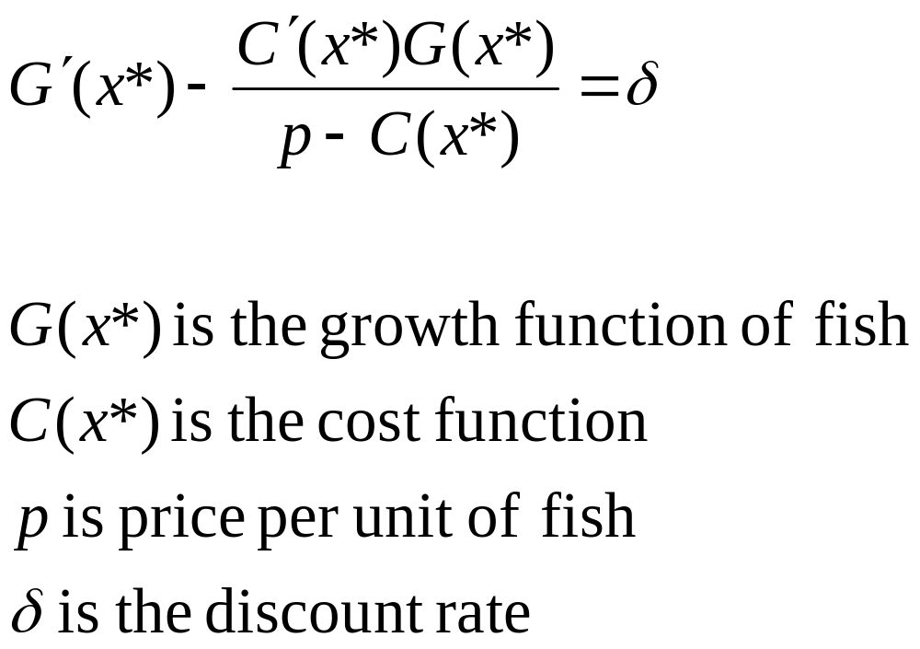
Clark and Munro(1975)

Slide 18
The basic bioeconomic model of Clark and Munro (1975)
x_{L}
Population, x
x_{M}
x_{H}
x₀
0
Time, t
The optimal population trajectory x = x(t) and optimal population for different discount rates
Adapted from a model developed by Clark and Munro (1975)

Slide 19
The basic bioeconomic model of Clark and Munro (1975)
x_{L}
Low disc. rate
Population, x
x_{M}
x_{H}
x₀
0
Time, t
The optimal population trajectory x = x(t) and optimal population for different discount rates
Adapted from a model developed by Clark and Munro (1975)

Slide 20
The basic bioeconomic model of Clark and Munro (1975)
x_{L}
Low disc. rate
Population, x
x_{M}
Medium disc. rate
x_{H}
x₀
0
Time, t
The optimal population trajectory x = x(t) and optimal population for different discount rates
Adapted from a model developed by Clark and Munro (1975)

Slide 21
The basic bioeconomic model of Clark and Munro (1975)
x_{L}
Low disc. rate
Population, x
x_{M}
Medium disc. rate
x_{H}
High disc. rate
x₀
0
Time, t
The optimal population trajectory x = x(t) and optimal population for different discount rates
Adapted from a model developed by Clark and Munro (1975)

Slide 22
Captured by Clark and colleagues
Economics of overexploitation (Clark, 1973);
  Intrinsic growth rate of fish (r);
  The discount rate (d);
d>r, could result in depletion of the stock.

Slide 23
Can economics help?
Is discounting a problem??
Individuals do not discount all future values at the same rate;
  Studies show that discount rates to be highest for choices involving relatively small amounts (Thaler, 1981; Hausman, 1979);
Individuals appear to apply higher discount rates to amounts with a short delay than amounts to be received further into the future (Bonzion et al., 1989);
Individual discount rates vary with personal characteristics, e.g., income (Gilman, 1976).

Slide 24
Alternative approaches proposed in the literature
Zero discount rate: Problematic;
Lower discount rate: How low?
  Hyperbolic discounting (Ainslie, 1974);
  Gamma discounting (Weitzman, 2001);
  Intergenerational discounting (Sumaila, 2004; Sumaila and Walters, 2005).

Slide 25
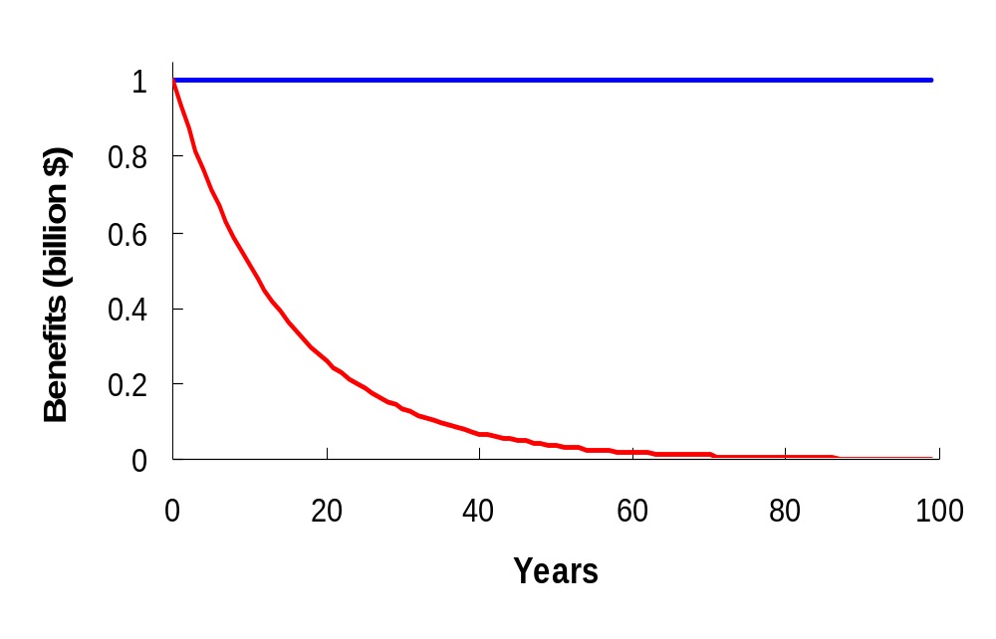
Flow of 1 unit of benefit in current and discounted value

Slide 26
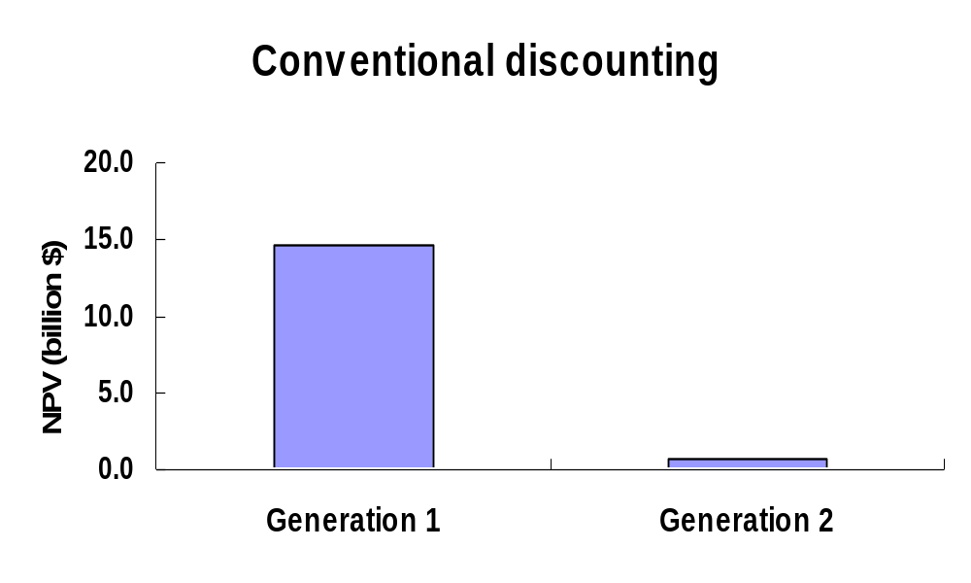
NPV accruing to each generation within 100 years based on conventional discounting

Slide 27
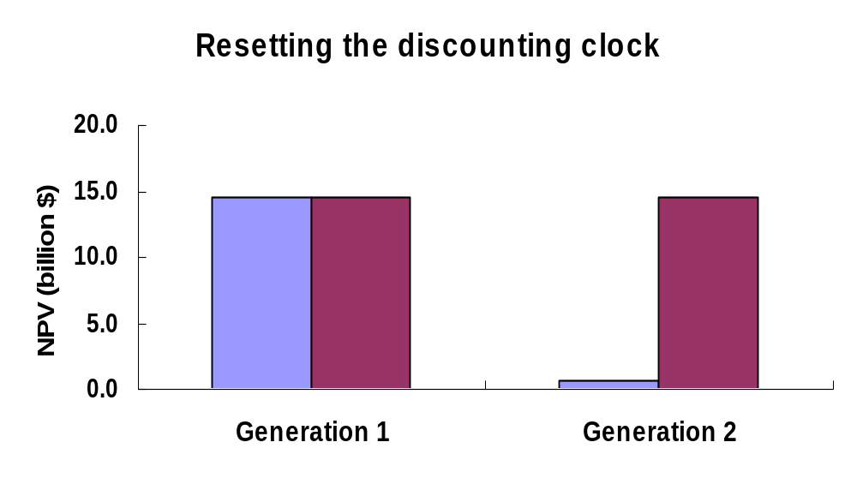
NPV accruing to each generation within 100 years based on intergenerational discounting

Slide 28
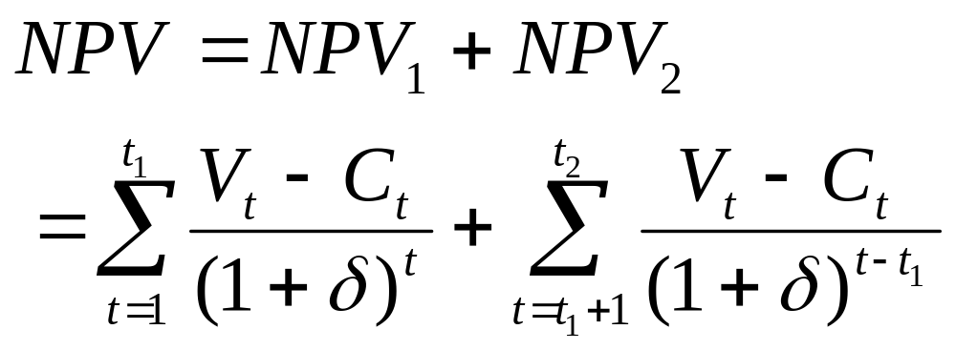
Intergenerational (IG) discounting: Discrete model
Sumaila (2004)

Slide 29
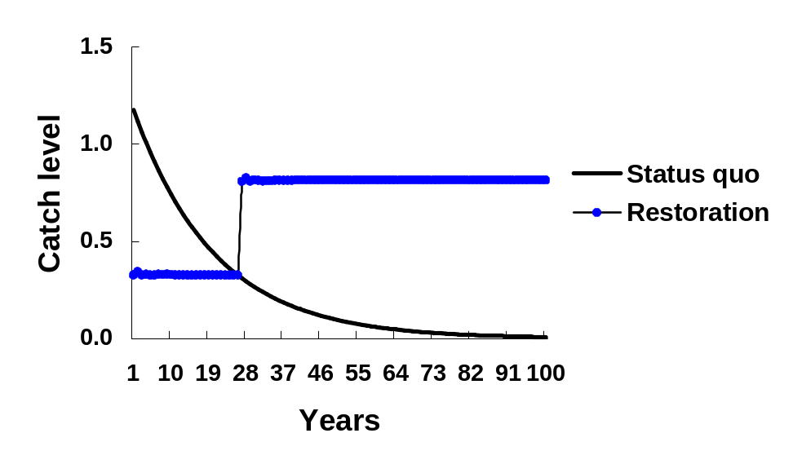
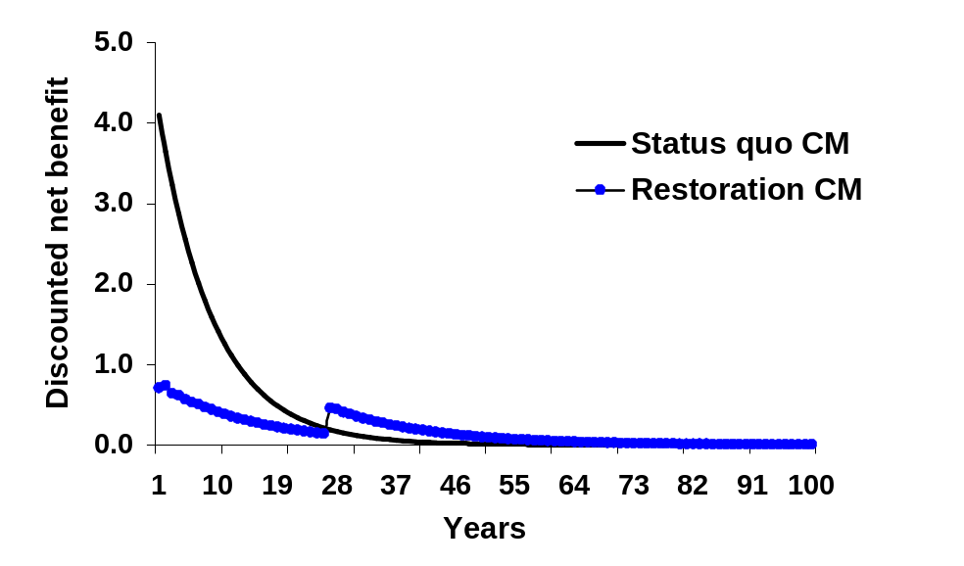
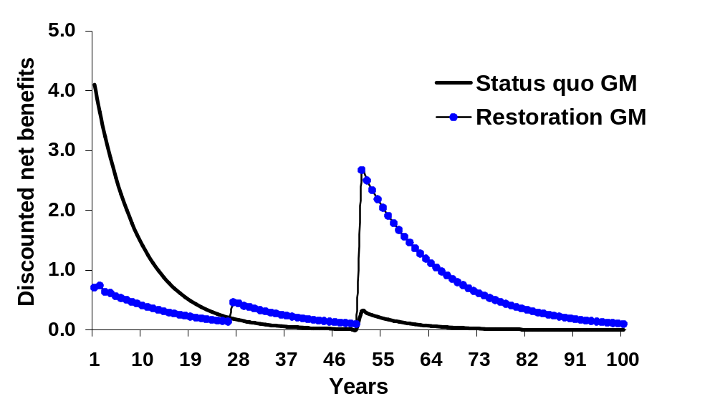
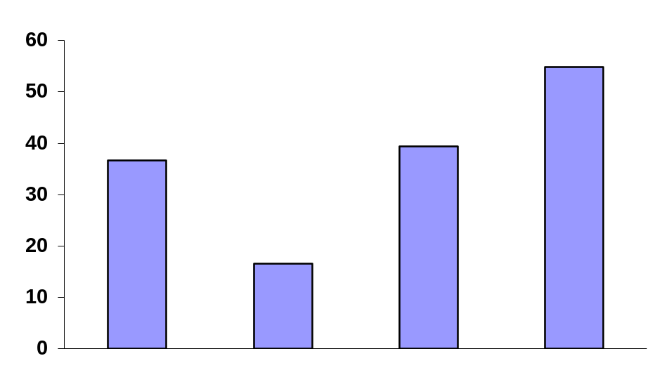
Total discounted net benefits
Status quo CM
Restore CM
Status quo GM
Restore GM
Sumaila (2004)

Slide 30
Continuous time IG discounting
Assumptions:
  Present generation discount flows of benefits at standard rate;
  New generation of size 1/G enters population each year: they discount at standard rate every year after entry;
  Current generation as decision makers discount the interest of future generations at a ‘future generation’ discount rate at the time they enter the population.
Sumaila and Walters (2005)

Slide 31
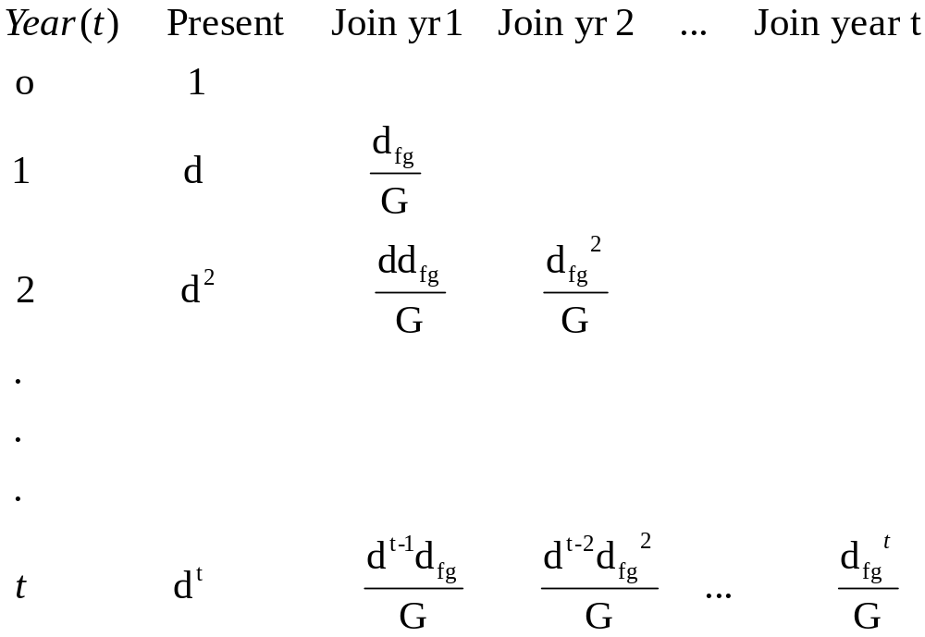
IG discounting tableau
Sumaila and Walters (2005)

Slide 32
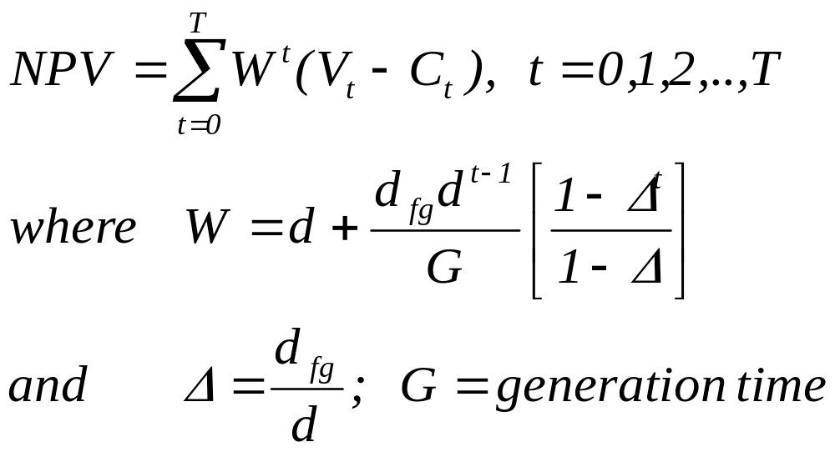
The IG bioeconomic model
Sumaila and Walters (2005)

Slide 33
Issues for discussion
AER: Axiom needed;
Time inconsistency;
Property rights to future generations;
Rawl’s theory with a time dimension.

Slide 34
Way forward – over to you Ivar

Slide 35
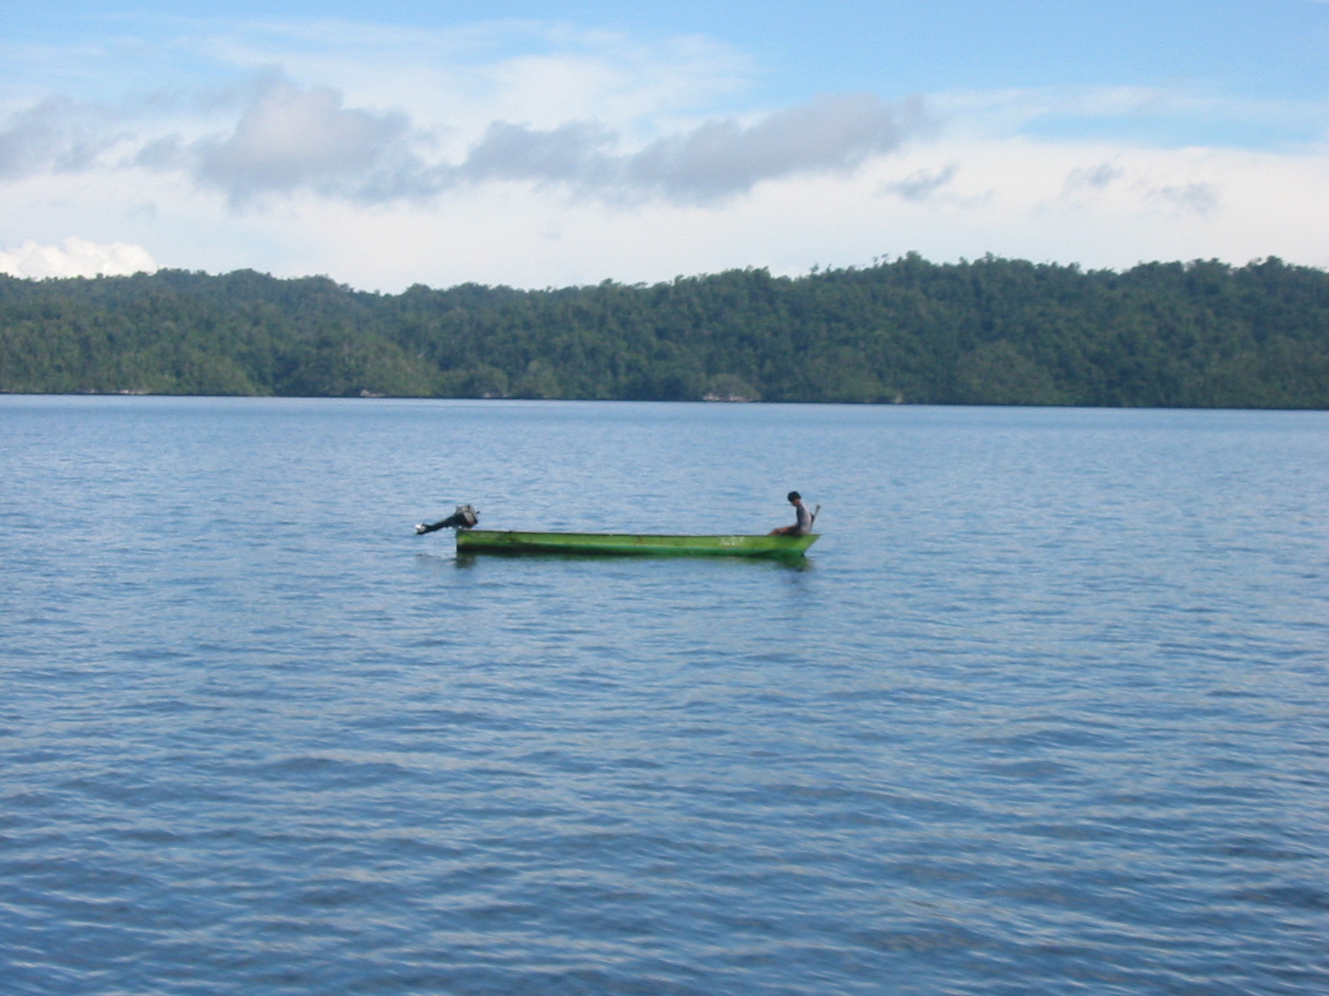
Thanks for your attention
Photo by Asep, TNC

Slide 36
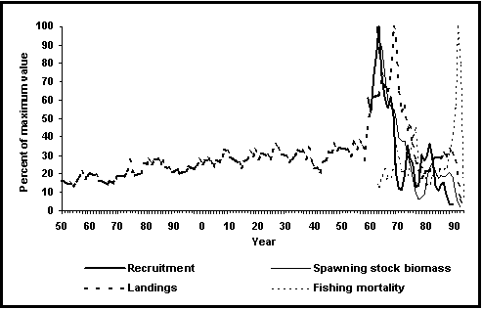
Newfoundland cod

